Slide 1
EECS448: Project 2: Android Calendar
By Team One:
Logan Ayer
Matthew Bauer
James Muoghalu
Luke Weaver

Slide 2
Overview
The app opens with a focus on a particular month within the Year View.
Clicking on a date three times will open up the Month View, Week View, and Day View.
A button inside Day View will lead the user to a page for adding an event.
A similar button exists on all four of the views to take the user directly to this page instead of going through all of the views.
Buttons on the “AddDetails” page will allow the user to select a start time, end time, start date, end date, and whether the event will be recurring for a given timeframe.

Slide 3
Summary of Our Team’s Additions
majority of additions were to the Java file that handled the addition of details and the XML file that acted as the user interface
some changes to Day View for displaying and organizing time frames
minor changes to week, month, and year view for adding events to the current date

Slide 4
Division of Labor
Logan
weekly and biweekly recurring events
Matt
UI alterations and database work; UML class diagram; Day, Week, Month, and Year View modifications
James
weekly, biweekly, and monthly recurring events; UI alterations; presentation
Luke
retrieving timeframe data; UML use-case and state diagrams

Slide 5
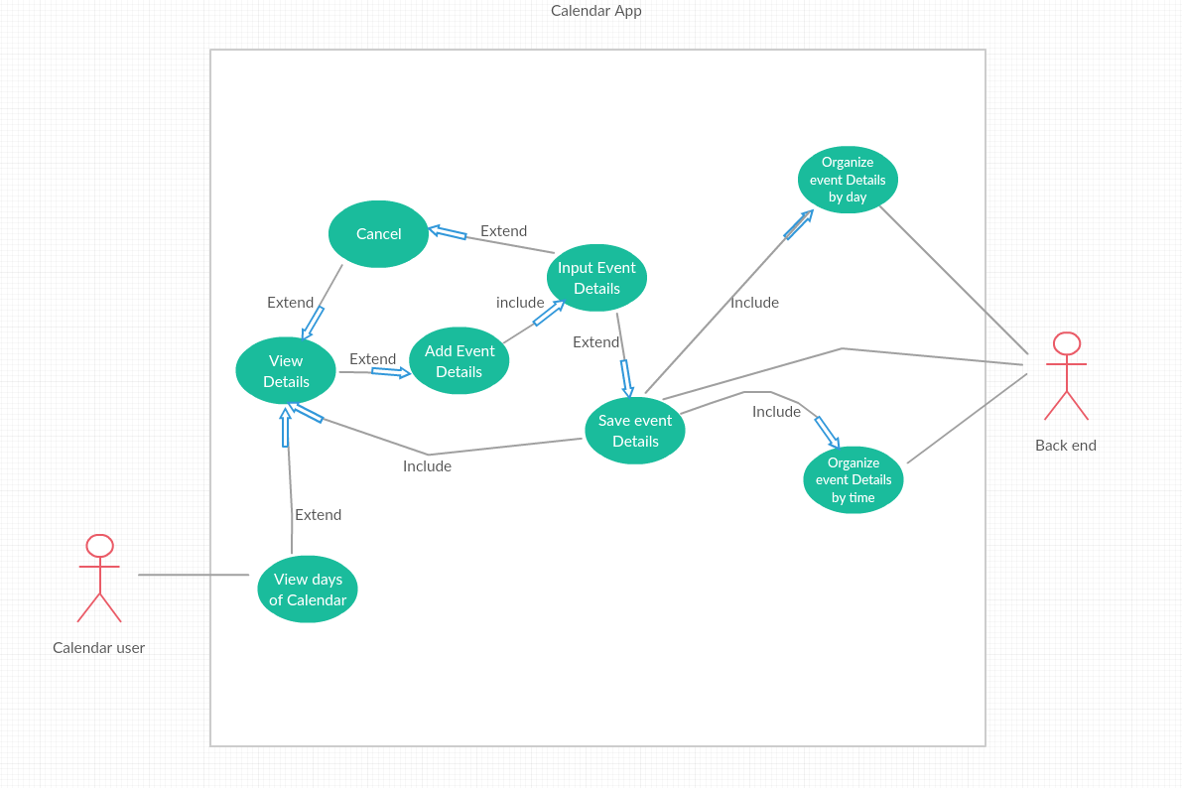
UML: Use-Case Diagram

Slide 6
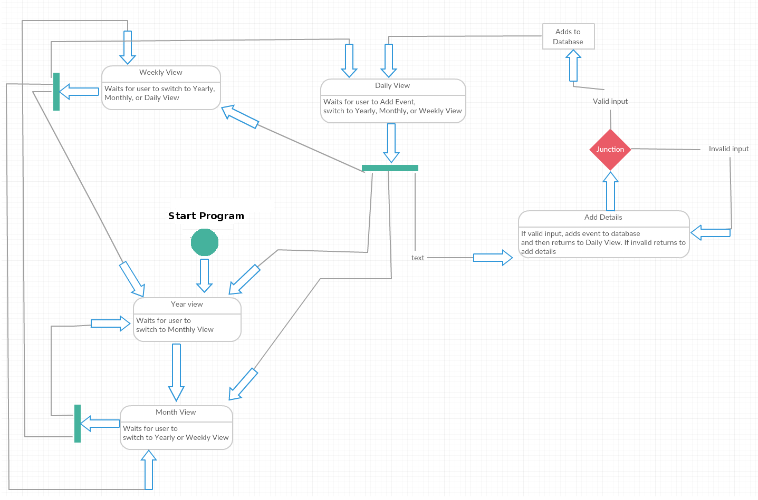
UML: State Diagram

Slide 7
UML: Class Diagram

Slide 8
Challenges
finding a way to add the recurring events without changing the current date being looked at
Solution: iterating through a duplicate of the calendar and adding an event to the original database at the appropriate times
collecting the user’s selections for timeframes, recurring events, etc.
Solution: manipulating instances of the Calendar class based on changes to the Android UI elements
cluttering of the “AddDetails” XML page
Solution: addition of a scrolling feature

Slide 9
Some Sources Used
Java Calendar and GregorianCalendar classes
Android UI elements and corresponding Java functions
the original group’s database and event-adding classes as a basis for our new code

Slide 10
Retrospective, etc.
We were able to add all desired features to our project.
What We Would Have Done Differently
more group meetings, especially before the break
more thorough study of the old group’s code, especially since we were mostly unfamiliar with Android as a platform

